Slide 1
Multimedia Systems Lecture – 12
By
Dr. Priyambada Subudhi
Assistant Professor
IIIT Sri City

Slide 2
Video
Video, whether analog or digital, is represented by a sequence of discrete images shown in quick succession. Each image in the video is called a frame, which is represented as a matrix of pixels defined by a width, height, and pixel depth.
In addition, two important properties govern video representation: frame rate and scanning format.
The rate at which the images are shown is the frame rate.
If the frame rate is too slow, the human eye perceives an unevenness of motion called flicker.

Slide 3
Although digital video can be considered a three-dimensional signal—a 2D image changing over time—analog video is converted to a 1D signal of scan lines.
This scan line conversion was introduced to make analog television broadcast technology work, and is central to the manner in which televisions (and all other cathode-ray tubes) display images.
The electron gun(s) in a television project electrons on the phosphor screen from left to right in a scan line manner and from top to bottom successively for each frame.
The phosphor screen glows at each location on a scan line creating a color at all positions on the line.
Scanning formats, which is an outcome of the analog technology, can be represented as interlaced or progressive.

Slide 4
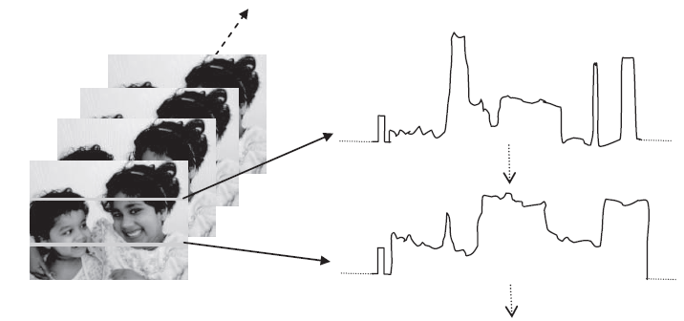
Left: Video is represented as a sequence of images. Right: Analog video of one frame scanned as a 1D signal. Each scan line is scanned from left to right as an analog signal separated by horizontal syncs. Two scan lines are shown; each begins with a horizontal sync and traces through the intensity variation on that scan line.

Slide 5
Digital display technologies display media in a digital format. Digital video display on these devices, such as LCD or plasma, does not require the scanning mechanism described previously. However, when the technology for digital video started to evolve, the television instruments were still rendering analog signals only. As a result, the digital video standards have their representations and formats closely tied to analog TV standards.

Slide 6
Analog Video and Television
Analog video signal used in broadcast is scanned as a one-dimensional signal in time, where the spatiotemporal information is ordered as a function of time according to a predefined scanning convention.
This 1D signal captures the time-varying image intensity information only along scanned lines.
Television requires this analog scanned information to be broadcast from a broadcast station to all users.
The standardization process implemented in the broadcast of analog video for television mandated a few requirements, which were necessary for making television transmission viable: YUV color space conversion and interlaced scanning.

Slide 7
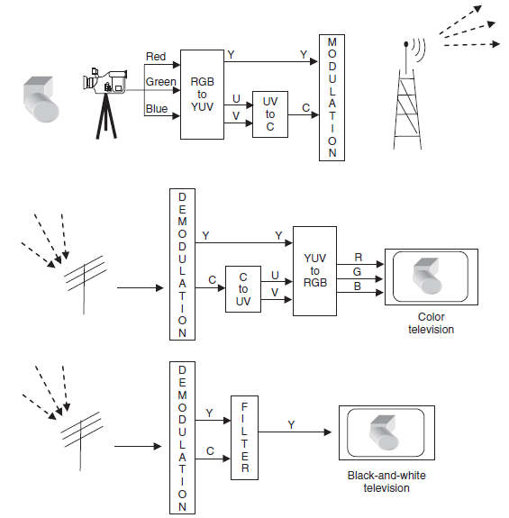
Television works by sending scan line information in interlaced YUV format.

Slide 8
Conversion to YUV
Video frames, like images, are represented using a color format, which is normally RGB. This RGB color space is used by cathode-ray tube–based display devices, such as the television, to display and render the video signal.
For transmission purposes, however, the RGB signal is transformed into a YUV signal. The YUV color space aims to decouple the intensity information (Y or luminance) from the color information (UV or chrominance).
The separation was intended to reduce the transmission bandwidth and is based on experiments with the human visual system, which suggests that humans are more tolerant to color distortions than to intensity distortions.

Slide 9
Analog Video Scanning
Video is scanned as a 1D signal, where each raster line is interspaced with horizontal and vertical syncs.
For horizontal synchronization in analog video, a small voltage offset from zero is used to indicate black and another value, such as zero, to indicate the start of a line.
Vertical synchronization is carried out by the cycles in the power outlet (60 Hz for NTSC, 50 Hz for PAL). Every 1/60th of a second, the electron gun is reset by the vertical sync to draw the beginning of the next frame.

Slide 10
In TV and in some monitors and multimedia standards, another system, interlaced scanning, is used.
Here, the odd-numbered lines are traced first, then the even-numbered lines. This results in “odd” and “even” fields—two fields make up one frame.
But the resulting video drawn by interlaced scanning techniques might be unacceptable and has occasional flicker and artifacts. This is caused because the video is captured at different moments in time as two field and, hence, interlaced video frames exhibit motion artifacts when both fields are combined and displayed at the same moment.
Video is of better quality when it is captured progressively and drawn progressively, which eliminates the occasional flicker.

Slide 11
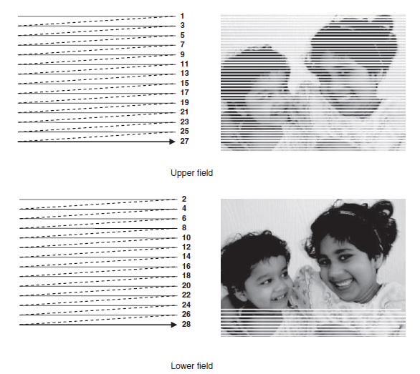
Interlaced scanning. The top figure shows the upper “odd” field consisting of odd-numbered lines. The bottom shows a lower “even” field interspersed with the odd field. Both fields are shown in succession to meet the required frame rate.

Slide 12
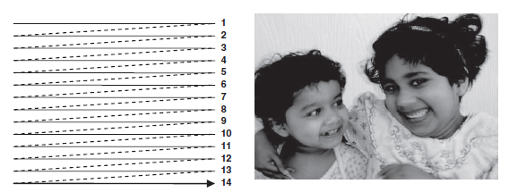
Progressive scanning. All the scan lines are drawn in succession, unlike in the interlaced case.

Slide 13
Analog Video Standards
NTSC Video
NTSC, named for the National Television System Committee, is the analog television system that is mostly used in most of North America and Japan.
It uses a familiar 4:3 aspect ratio (i.e., the ratio of picture width to height) and 525 scan lines per frame at 30 fps.
NTSC video is an analog signal with no fixed horizontal resolution. Therefore, we must decide how many times to sample the signal for display. Each sample corresponds to one pixel output. A pixel clock divides each horizontal line of video into samples. The higher the frequency of the pixel clock, the more samples per line.

Slide 14
PAL Video
PAL (Phase Alternating Line) is a TV standard originally invented by German scientists.
It uses 625 scan lines per frame, at 25 frames per second (or 40 msec / frame), with a 4 : 3 aspect ratio and interlaced fields.
This important standard is widely used in Western Europe, China, India and many other parts of the world.
PAL uses the YUV color model with an 8 MHz channel, allocating a bandwidth of 5.5 MHz to Y and 1.8 MHz each to U and V.
To improve picture quality, chroma signals have alternate signs (e.g., +U and — U) in successive scan lines; hence the name "Phase Alternating Line.
This facilitates the use of a (line - rate) comb filter at the receiver — the signals in consecutive lines are averaged so as to cancel the chroma signals (which always carry opposite signs) for separating Y and C and obtain high - quality Y signals.

Slide 15
SECAM Video
SECAM, which was invented by the French, is the third major broadcast TV standard.
SECAM stands for Systeme Electronique Couleur Avec Memorie.
SECAM also uses 625 scan lines per frame, at 25 frames per second, with a 4:3 aspect ratio and interlaced fields.
SECAM and PAL are similar, differing slightly in their color coding scheme.
In SECAM, U and V signals are modulated using separate color subcarriers at 4.25 MHz and 4.41 MHz, respectively. They are sent in alternate lines - that is, only one of the U or V signals will be sent on each scan line.

